Slide 1
BW Intl Inventory Solution to HANA
May 2019

Slide 2
Agenda
As-IS Data flow
Proposed Solution
To-Be Architecture
Volume and Performance

Slide 3
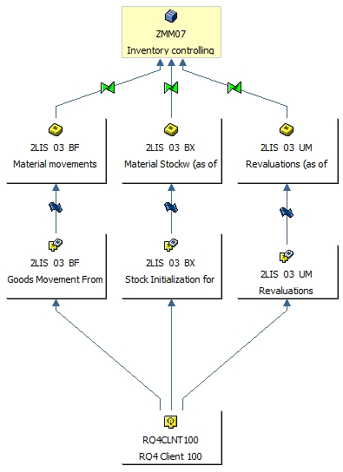
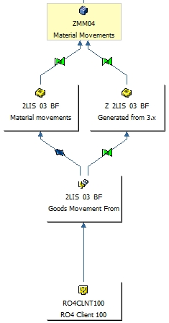
As-Is Architecture
Two Data flow based on the 2LIS_* data source 3.X data flow, 90% of the std. BI content objects
Cube - ZMM07 for Summary and Cube-ZMM04 for detail
60 Bex reports based on the last 3 years of usage
339M records in ZMM04 and 90M in ZMM07. Delta volume Approx. 80K records

Slide 4
Solution approach
Option 1: Migration of Existing Data Model
Keep the Key Figure base model Data in the existing system
Option 2 : Implement HANA Optimized model
Implement the HANA optimized Account based model
Create aDSO/Cube same as ZMM07/ ZMM04 structure
Convert/Copy the existing the 3.x transformation to 7.x transformation
Copy the Query based on top of ZMM07/ ZMM04 based on the production usage
Install the HANA optimized content
Enhance the Data aDSO/Composite provider to include the custom fields
Create new BEX Query based on the production usage
As current model is based on Key figure based, More database space is required and Transformation logic needed to populate each key figure
Pros and Cons
Account based model, Three key figures: Stock quantity, stock value and valuated stock quantity
Uses less database space
Pros and Cons
Need to re-create the Bex Query
Easy to implement
Less load in OLAP processor as all the Key figures are already calculated
The load for the OLAP processor is higher and there is more work during the query definition

Slide 5
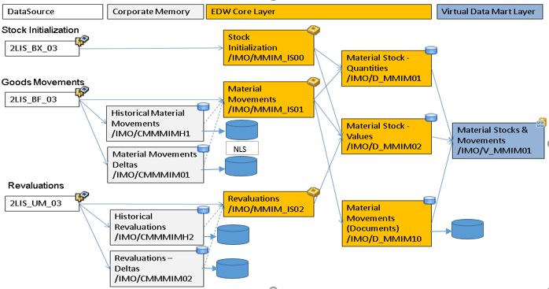
Recommended architecture
Key Features
LSA++ Architecture incl. corporate memory
Usage of aDSO and Composite provider
Virtual Data Mart Layer
Account based model
Three key figures: Stock quantity, stock value and valuated stock quantity
Advantage: Uses less database space, less rule groups required in BW transformations, more flexibility when creating/adjusting key figures without need to reload data.
Disadvantage: The load for the OLAP processor is higher and there is more work during the query definition.
Hana Optimized BI Content

Slide 6
Volume/Performance Consideration
Corporate Memory aDSO will be stored in Cold Memory via NLS
6 month’s of historical movement will be stored in Hot memory and rest of the data will be stored in cold memory
Based on 3 year’s of usage, 60 Bex query can be consolidated to 15 to 20 query

Slide 7
SAP Note and Links for Inventory
SAP Note | Document
586163 - Composite SAP Note for SAP ERP Inventory Management in SAP BW
1548125 - Interesting Facts about Non-Cumulatives KeyFigure
2215265 - Near-line storage (NLS) for advanced DSO
2325774 - Data Mart Extraction from non-cumulative (ncum) InfoCubes and aDSOs
1932459 - DataSource Data loading to multiple SAP BW
2232584 - Release of SAP extractors for ODP replication
BW 7.5 Inventory mng
HANA Optimized BI-Content Link | https://help.sap.com/doc/saphelp_nw75/7.5.5/en-US/cb/29ad5518022e51e10000000a44147b/frameset.htm

